Slide 1
Challenges Faced in Online Classes
WE CONDUCTED A SURVEY ON THE

Slide 2
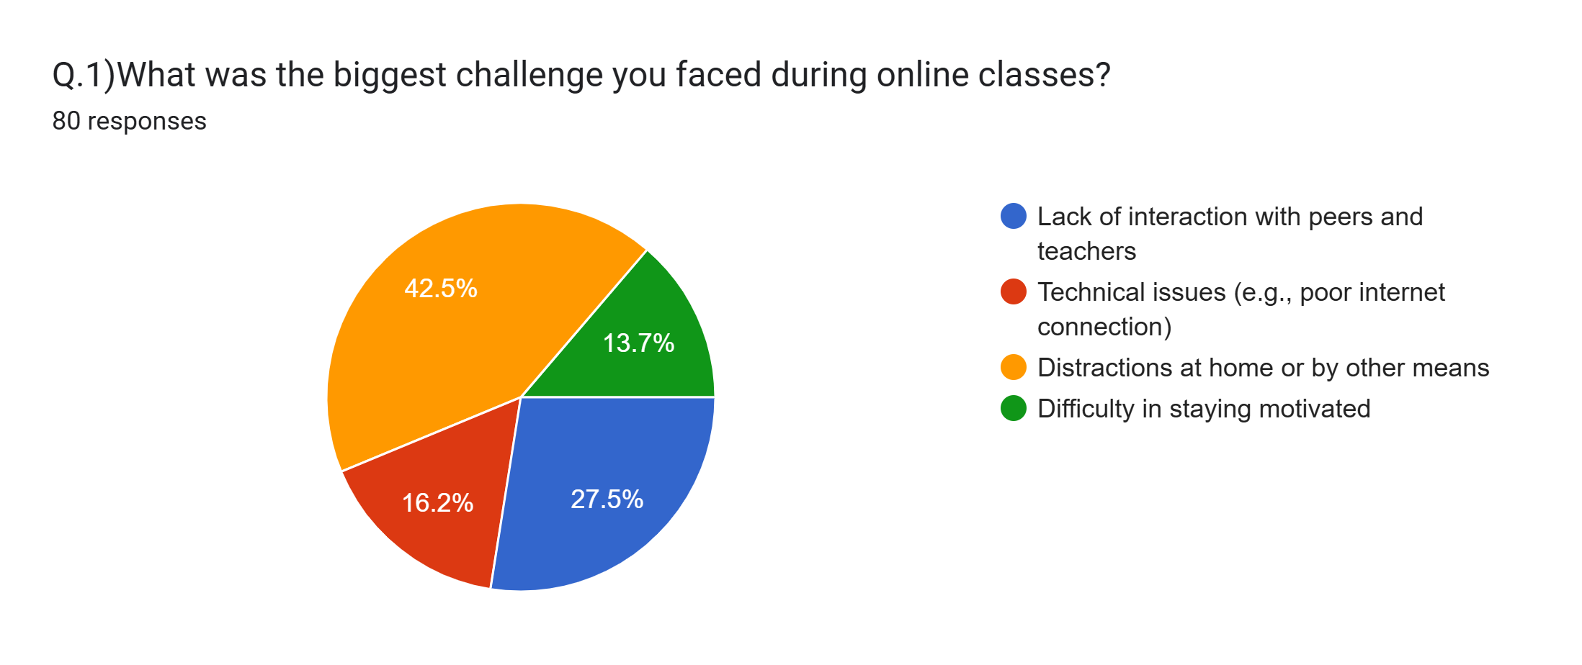
Challenges Faced in Online Classes
For the question, “What was the biggest challenge you encountered during online classes?”, The reports were:

Slide 3

Over 82% of students are reporting that they can’t stay focused and are constantly distracted by other means or that the student is not attentive in the lesson.
The problem is the lack of communication when compared to a real life classroom.

Slide 4

Hence as the solution for this, we introduce :
Class Insights

Slide 5


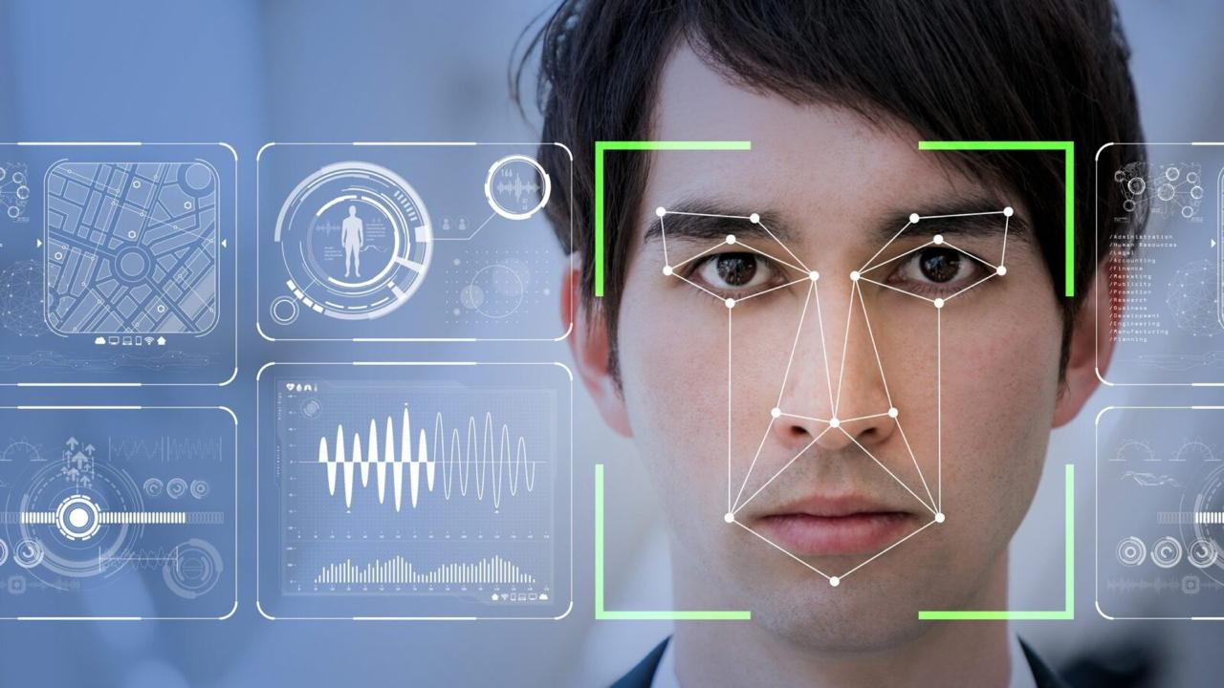
Class Insights
Class Insights is a plugin which uses Artificial intelligence and machine learning to provide real time assistance to the teachers and students
The machine detects whether you are bored or distracted by analysing your emotions and change in facial structure

Slide 6

Class Insights
The plugin uses Artificial intelligence and Machine learning to monitors the students reaction and give real time feedbacks and tips to the teachers.
The machines accuracy can be increased drastically by training it with various examples and testing it with many online classes

Slide 7
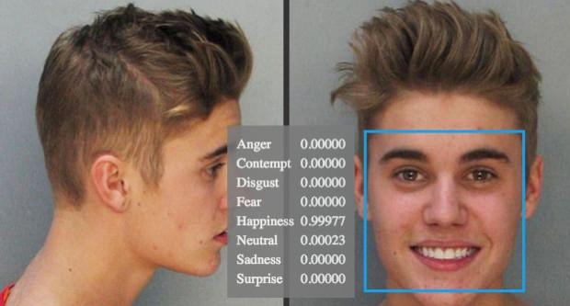
Class Insights
The plugin automatically notifies the student if they are distracted and can even send a report to the teacher.
The plugin even gives a report by the end of the lecture, by which the teacher can know of his shortcomings.

Slide 8
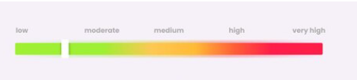
Class Insights
It even provides the teacher a progress bar for indicating the total student’s attentiveness

Slide 9
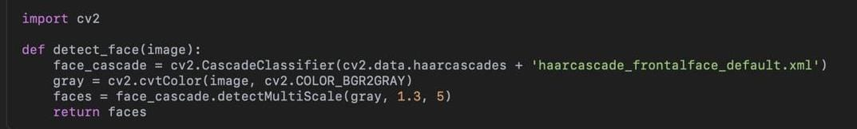
Class Insights
Main Code Used:
1)Face detection and alignment:
2) Model Evaluation
Notes:
vdfdstrdyy

Slide 10
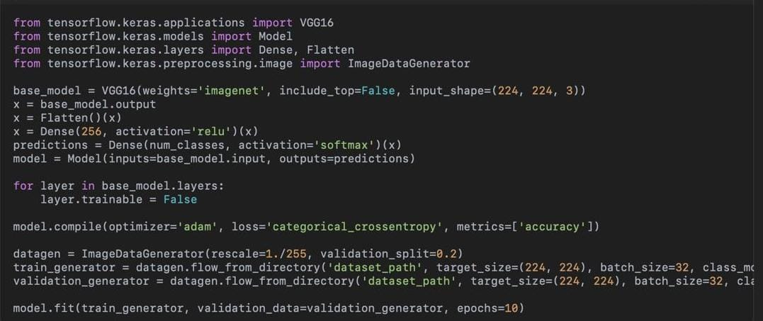
Class Insights
Main Code Used:
3) Model Training
Notes:
vdfdstrdyy

Slide 11
Class Insights
Notes:
vdfdstrdyy

